Slide 1
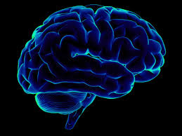

Bankruptcy Prediction
Communication is the key
By:
Akanksha Utreja(11910056)
Swapnil Vermani(11910052)

Slide 2
Executive Summary (Abstract)
Prediction of an enterprise bankruptcy is of great importance in economic decision making.
So, we use the Polish companies dataset available on UCI to find best models which can help predict companies that may go bankrupt.
Used Python and it’s libraries like scikit-learn for machine learning, seaborn and matplotlib for visualization etc.
Using different models like Logistic Regression, Decision trees, simple OLS model.
Out of the different models used, Decision trees had good performance.

Slide 3
Business Problem
The stakeholder of this project investors who are planning to invest in different companies, the companies themselves can figure our how long they can survive in present scenario and the banks can also use this while giving loans.
This will help companies to assess their situation and banks to give loans to potential companies.
With this project, the aim is to find the best model for bankruptcy prediction and the factors which most likely affect the bankruptcy.

Slide 4
Business Problem
Process used:-
Data Wrangling(Missing values, Data cleaning, standardization etc.)
Data Collection
EDA & Visualizations
Modelling:
Logistic
Decision Trees
OLS

Slide 5
Data Requirements & Collections
The data source used was on UCI website, it represents polish companies with 64 attributes.
Some of these companies were bankrupt between 2000 and 2012. Some of them were operational between 2007 and 2013.
It includes over 64 attributes along with 10,503 examples. The data was available in the form of arrff format.
It was read in the Python file and the analysis was performed on that data

Slide 6
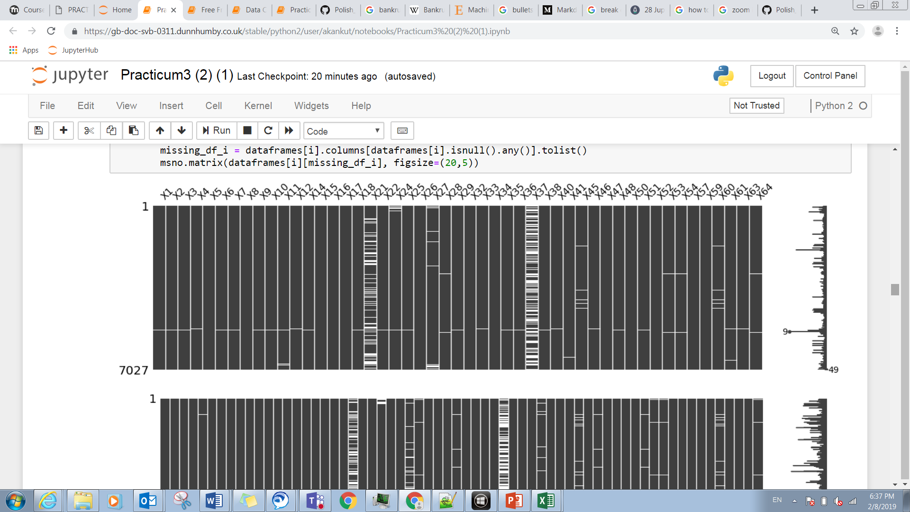
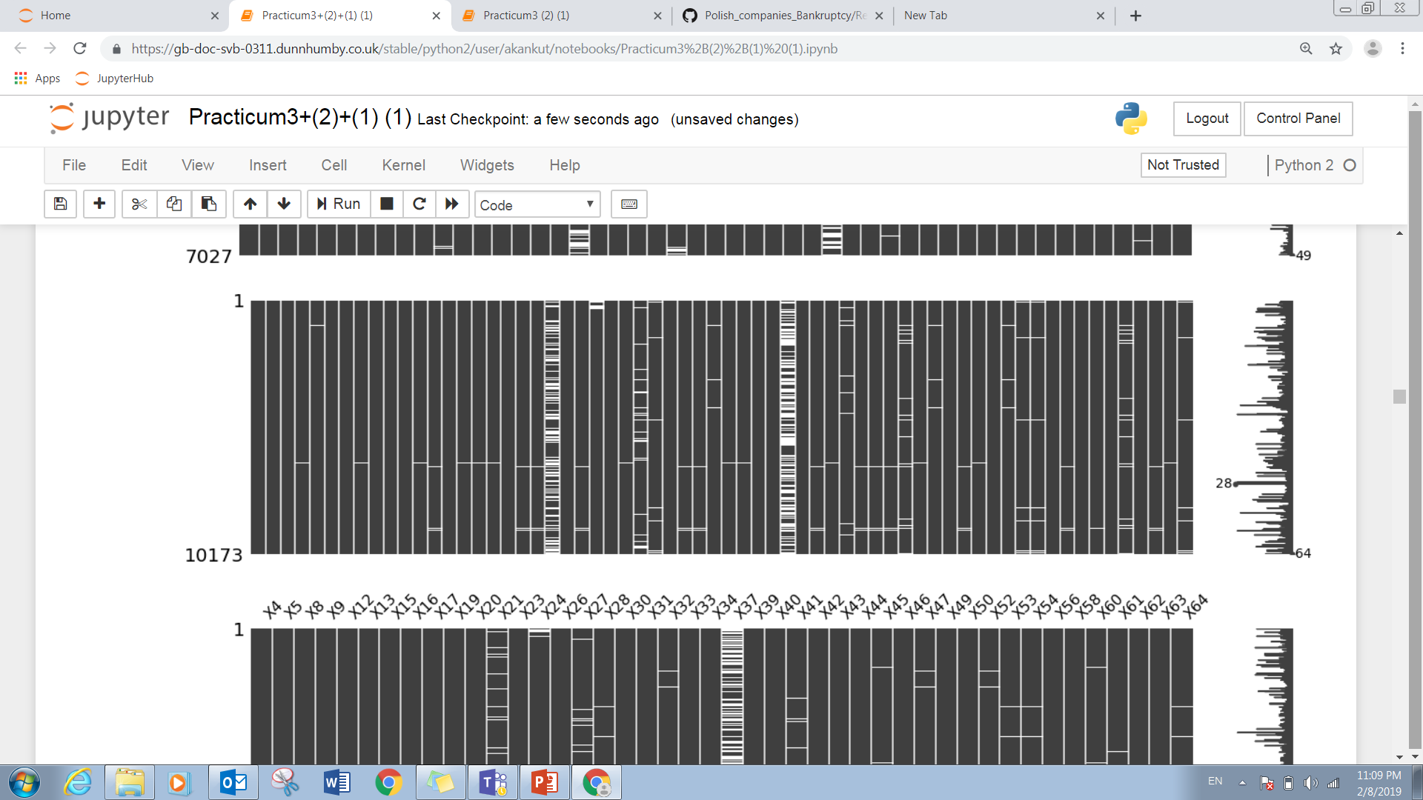
Data Understanding
Performing Exploratory data analysis to get a basic sense about the data.
We can see that there are many
Missing values

Slide 7
Data Understanding
We can also see that it is an imbalanced dataset,

Slide 8
Data Understanding
We can see from the sparsity matrix that column 37 has a lot of missing values in almost every year as speculated from the missing value count.
Hence, it is safe to say data needs to be imputed.
So, we have performed the following imputations:
1. Mean imputation
11. knn imputation
Thus, we got the data in shape for the modelling to be performed.

Slide 9
Data Preparation
We can see from the sparsity matrix that column 37 has a lot of missing values in almost every year as speculated from the missing value count.
Hence, it is safe to say data needs to be imputed.
So, we have performed the following imputations:
1. Mean imputation
To handle the imbalanced dataset we decided to go ahead with the cross validation technique and decided to keep number of folds equal to 5.
Thus, we got the data in shape for the modelling to be performed.

Slide 10
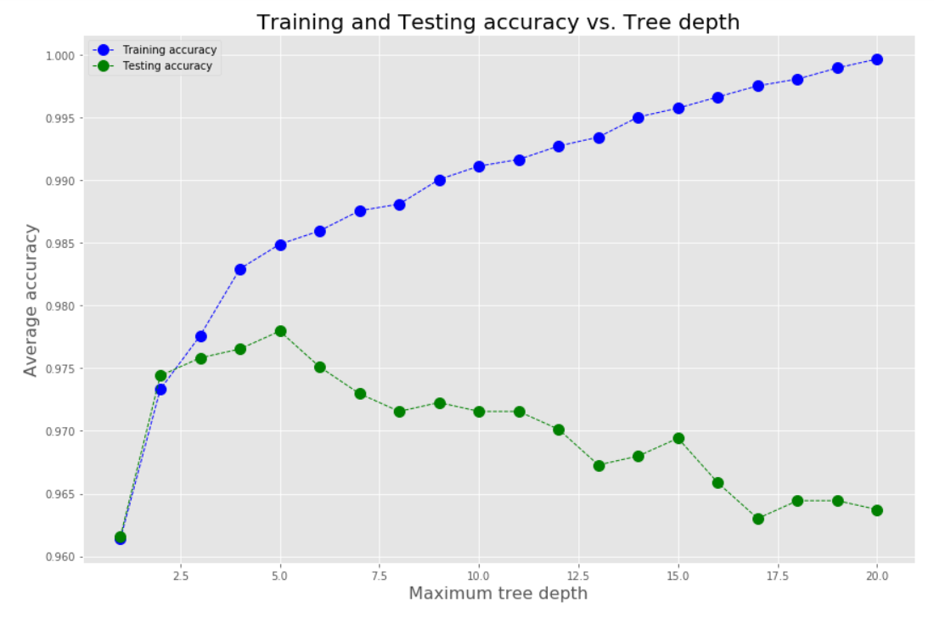
Modeling, Evaluation and Feedback
The models were chosen accordingly.
Logistic Regression (with L1 and L2 penalty used for imbalancing)
Decision trees (with appropriate depth)
Guassian Naïve Bayes
Random forest (ensemble)
Balanced Bagging (ensemble)
XgBoost

Slide 11
Modeling, Evaluation and Feedback
The following were used to analyse the performance of the model:
Accuracy
Classification summary (recall, precision, etc.)
Confusion matrix

Slide 12
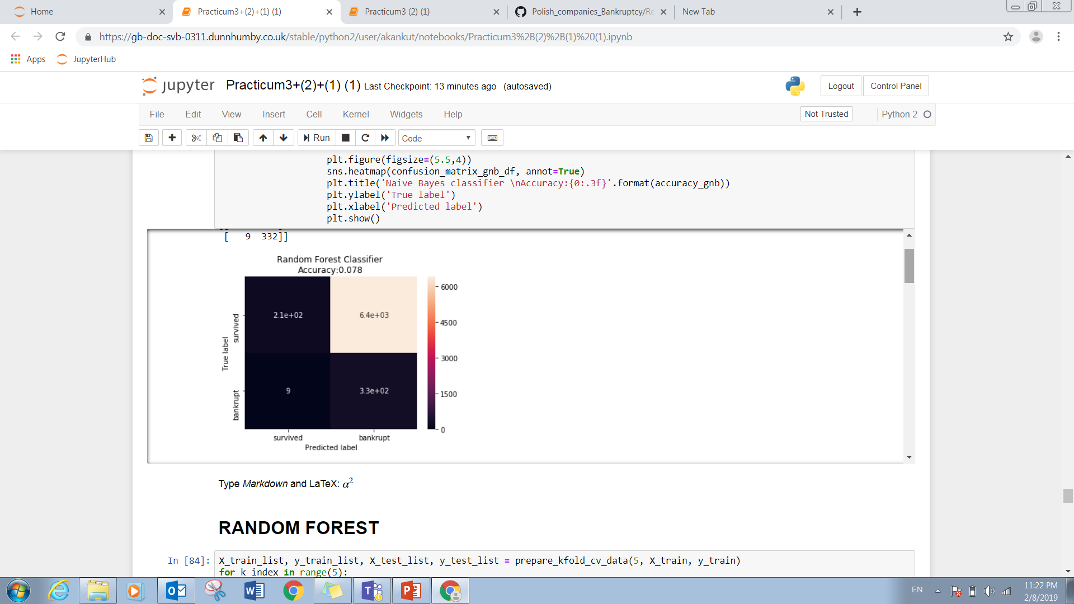
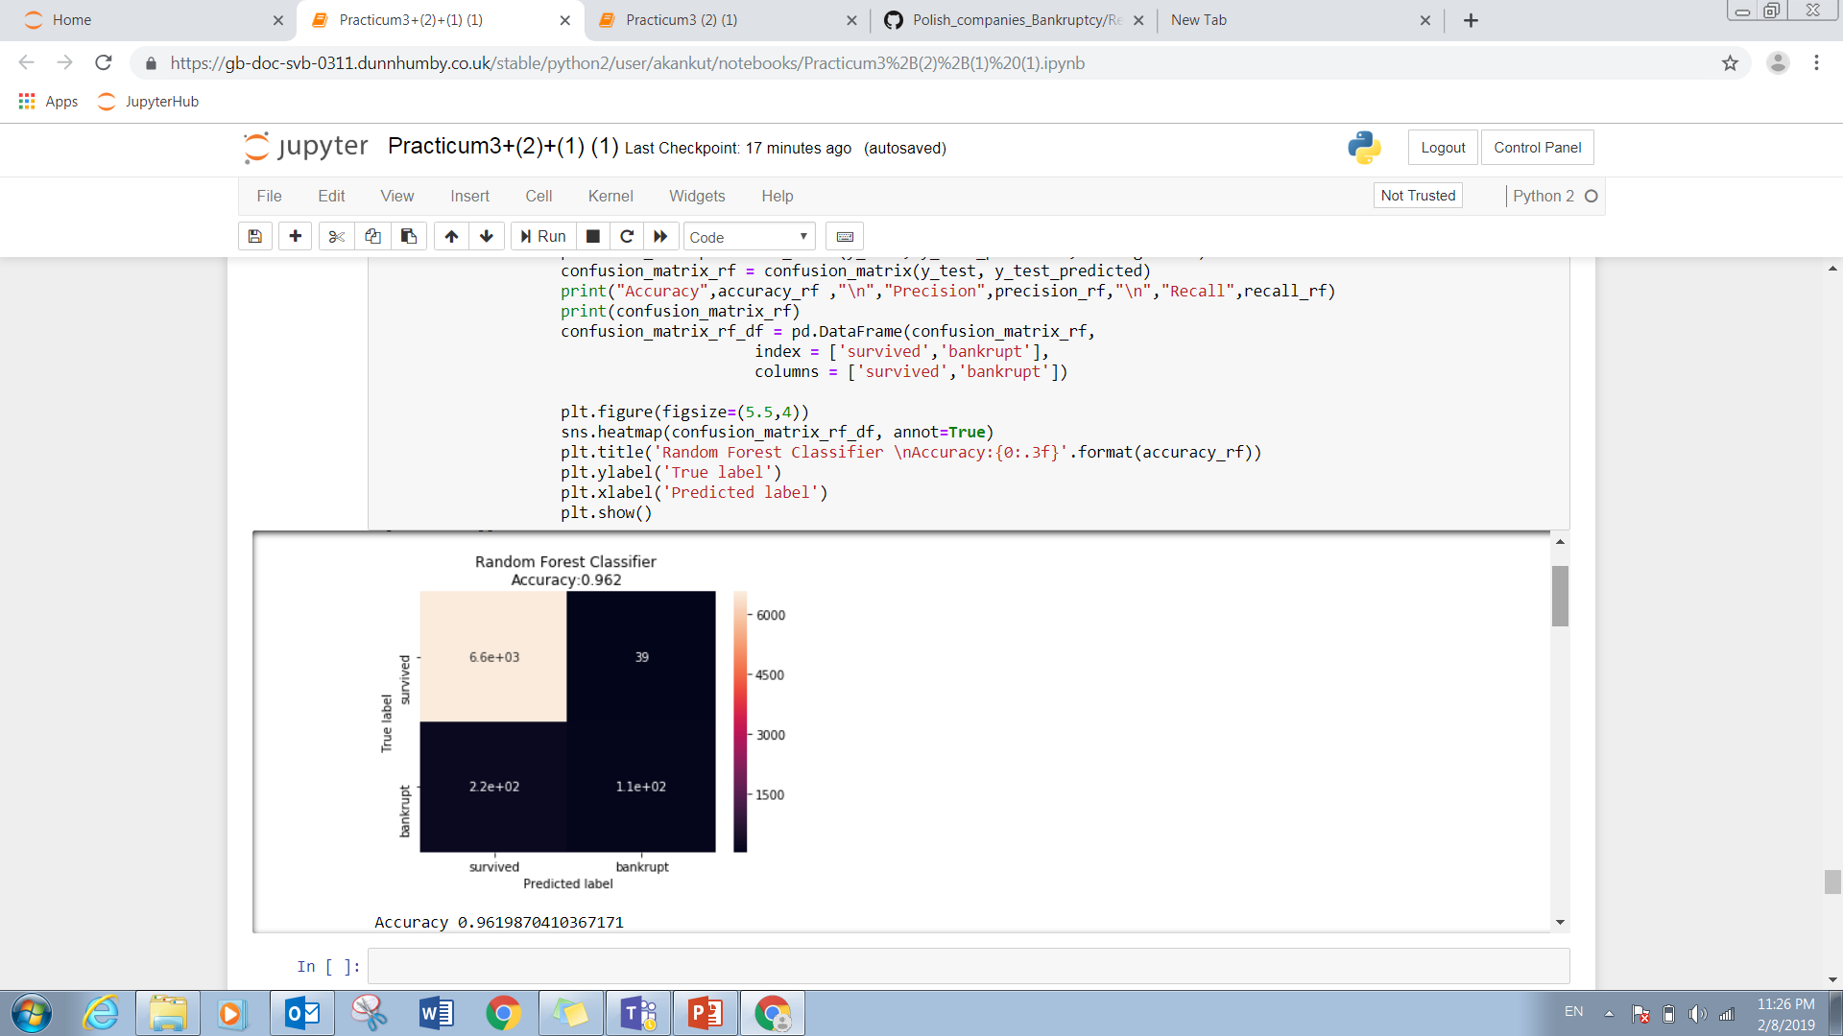
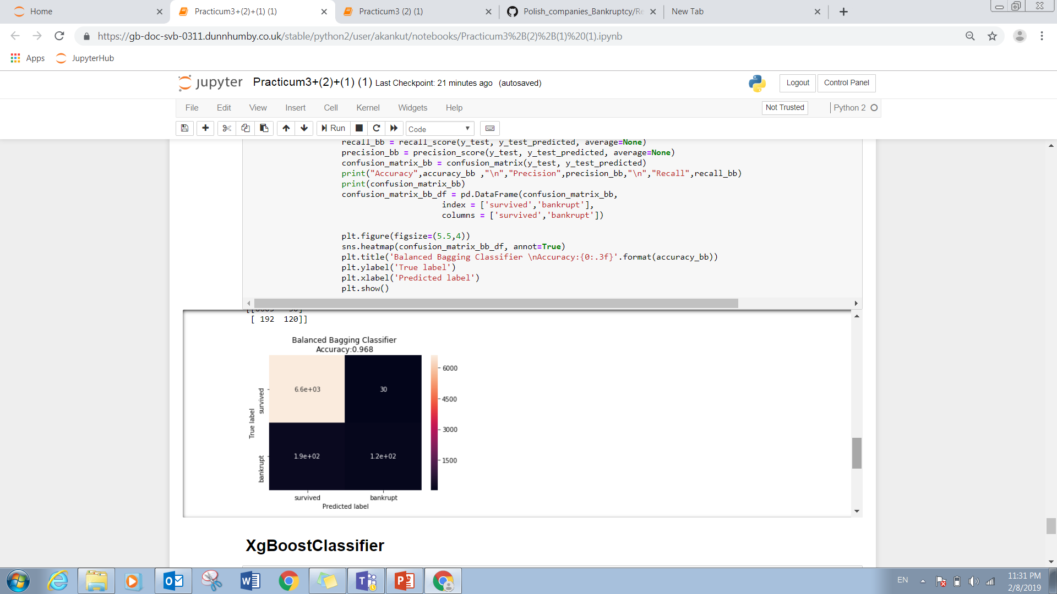
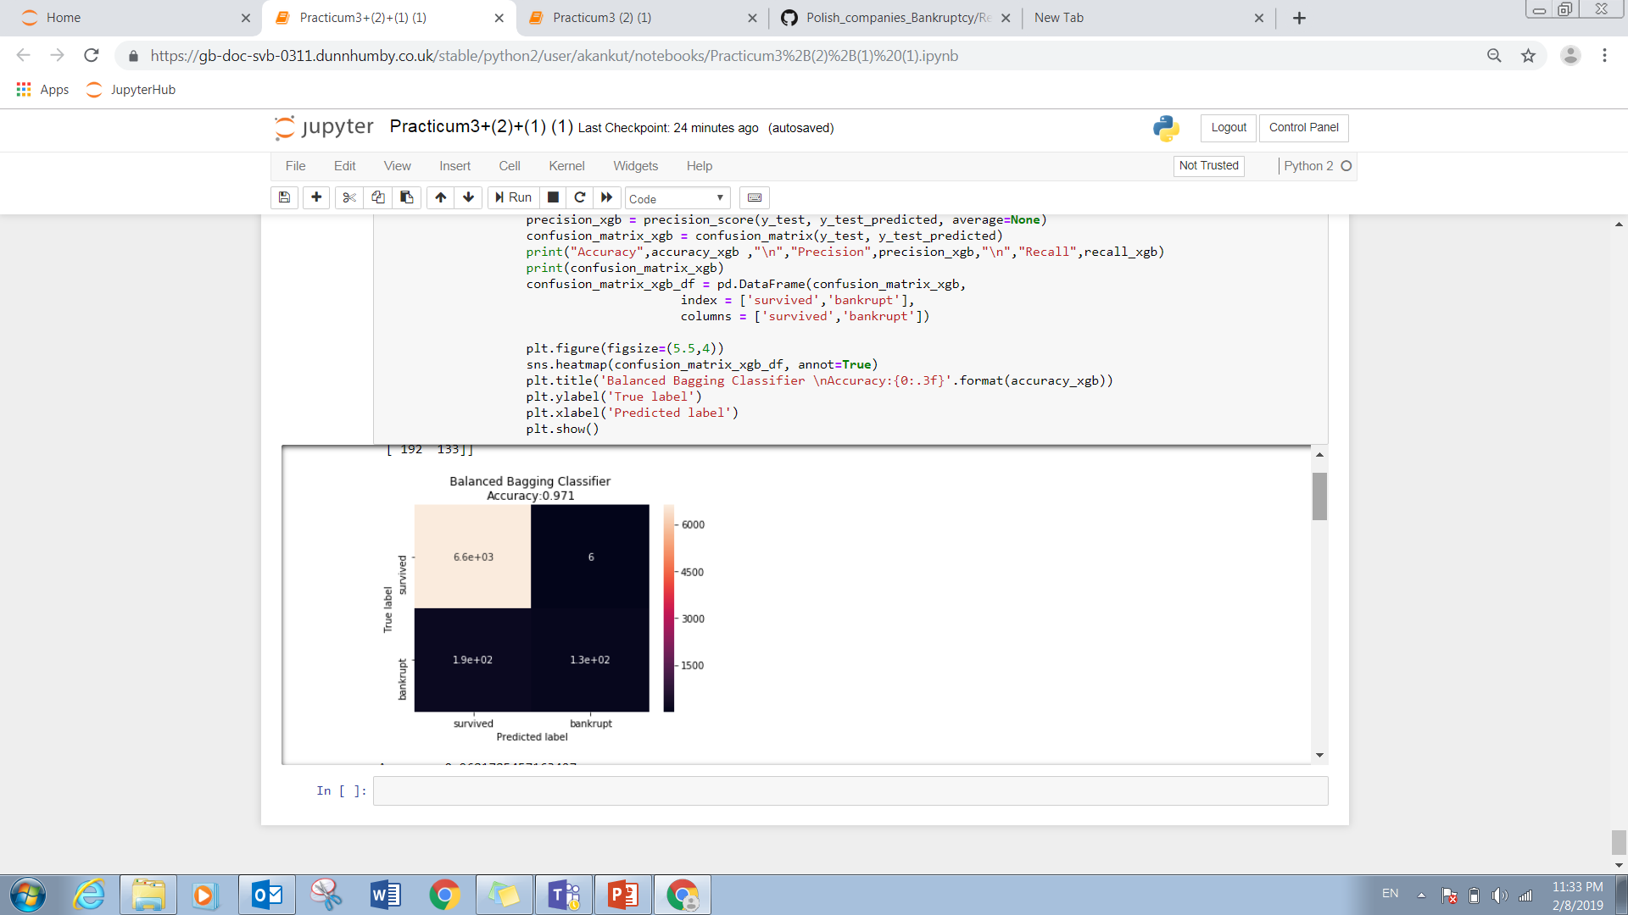
Modeling, Evaluation and Feedback
Gaussian Naïve Bayes:
Random forest
Balanced Bagging Classifier
XG Boosting

Slide 13
Modeling, Evaluation and Feedback
Comparing the accuracy of different ,
Models | Accuracy
Logistic Regression | 95.2%
Decision trees | 97.5%
Gaussian Naïve bayes | 7.8%
Random forest | 96.2%
Balanced Bagging | 96.8%
XGBoost | 97.1%

Slide 14
Business Recommendations
From deploying multiple models, we can say that XG best predicts the accuracy
By using the data in the same way, we can now predict when can a company go bankrupt which can be of great economical importance.
We can also suggest banks, which variables are the best to predict the bankruptcy of the companies.

Slide 15
Assumptions, Limitations & Further Works
We could have used more sampling and imputation techniques.
More data preprocessing could have been performed to improve the model accuracy further. So, in future this is one area which can be explored.
Variations of different machine learning techniques can be used.

